Slide 1
Case Study Title
CRM CASE STUDY

Slide 2
Name
Personal Info
Etc.

Slide 3
Question Policy

Slide 4
Overview
Objectives
Critical Skills Review
Case Study Focus Skill
Synopsis
Focus Questions

Slide 5
Objectives
Terminal Objective
Enabling Objective

Slide 6
Crew Resource Management
Allows crew to interact effectively while performing mission tasks
A program to effect behavior modifications in order to prevent human factor and crew preventable errors
To improve mission effectiveness through increased awareness of associated behavioral skills
What does CRM mean to me?

Slide 7
CRM Critical Skills Review
Decision Making (DM)
Assertiveness (AS)
Mission Analysis (MA)
Communication (CM)
Leadership (LD)
Adaptability/Flexibility (AF)
Situational Awareness (SA)

Slide 8
Case Study Focus Skill
COMMUNICATION
The ability to clearly and accurately send and receive information, instructions, or commands; and provide useful feedback

Slide 9
Process of Communication
Sender’s responsibilities
- Communicating information clearly, accurately,
concisely, and in a timely manner
- Requesting verification or feedback
- Verbalizing plans
Receiver’s responsibilities
- Acknowledge communication
- Repeat information
- Paraphrase information
- Clarify information
- Provide feedback

Slide 10
Why is communication important?
Conduct effective missions
Avoid mishaps
Pass information from one person to another
Maintain group situational awareness

Slide 11
Overcoming Barriers
Use active listening techniques
Require feedback
Use appropriate mode of communication and decibel level
Use standard terminology

Slide 12
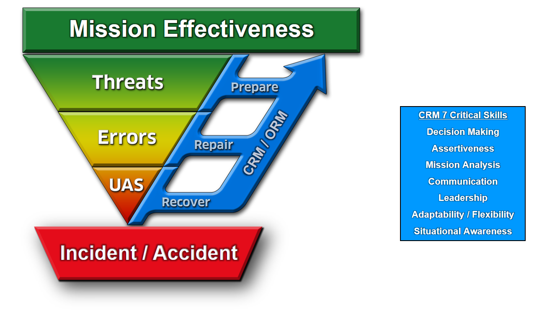
Threat and Error Management
TEM is what we do. CRM is how we do it.
Notes:
MASTER TEM SLIDE

Slide 13
Why Threat & Error Management?
In the past: We focused on eliminating human error in aviation.
Contemporary acknowledgement: Errors are inevitable, so…
We must instead focus on ways to effectively MANAGE and REDUCE errors

Slide 14
Mission Effectiveness
MISSION EFFECTIVENESS

Slide 15
Mission Effectiveness
MISSION EFFECTIVENESS
What is a mission?

Slide 16
Mission Effectiveness
MISSION EFFECTIVENESS
A Mission is the Task + Purpose

Slide 17
Mission Effectiveness
MISSION EFFECTIVENESS
How is Effectiveness defined?

Slide 18
Mission Effectiveness
MISSION EFFECTIVENESS
How is Effectiveness defined?
Completing the task to specific standards:
Time / Cost / Quality

Slide 19
Mission Effectiveness
MISSION EFFECTIVENESS
Mission Effectiveness is completing the task to specific standards in order to fulfill the purpose.

Slide 20
Mission
MISSION EFFECTIVENESS
Task + Purpose

Slide 21
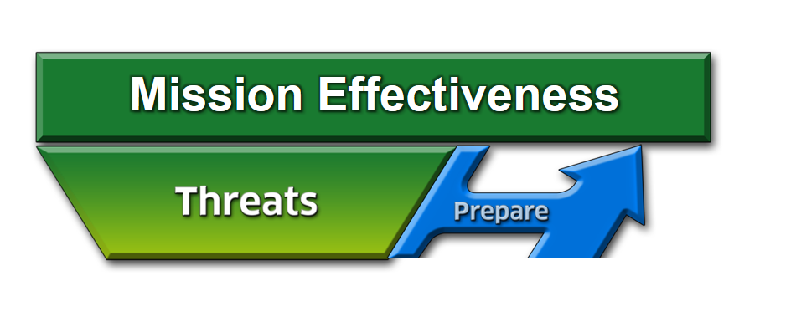
Threats
A THREAT is anything that increases operational complexity that, if not managed properly, can decrease the safety margins.

Slide 22
Threats
How do we operate in spite of the fact that we cannot eliminate the THREATS from aviation?
Effectively PREPARE for and manage them
22 of 20
Notes:
22

Slide 23
Threats
What is our strategy to manage threats?
Identify and PREPARE

Slide 24
Strategies to Prepare for Threats
Things we can use to counter threats:
ORM
Clearly defined roles of aircrew members
Complete briefing and effective communication
Limit being “heads down” at critical times
NATOPS / System Knowledge
CRM
Notes:
24

Slide 25
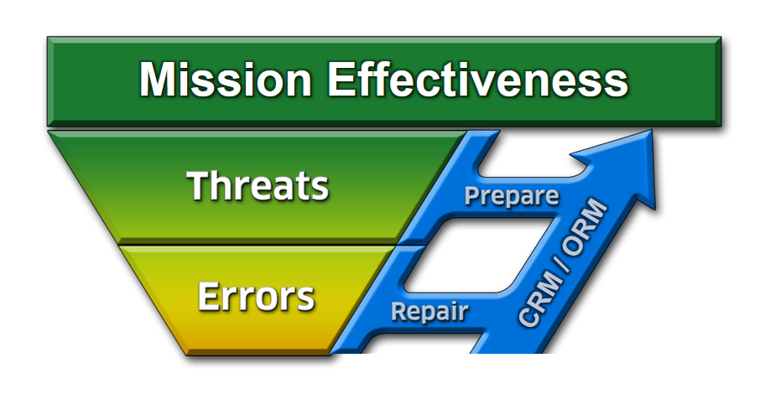
Errors
What can happen if we ignore or mismanage a THREAT?
25 of 20

Slide 26
Definition of Error
Error:
Crew action or inaction that leads to deviations from expectations and reduces safety margins
May occur from either mistakes or mismanaged threats
Error Management:
Process of correcting an error before it becomes consequential, i.e. Undesired Aircraft State and Incident/Accident
Notes:
26

Slide 27
Categories of Errors
Procedural - Following procedures but wrong execution (wrong altitude on course rules)
Communication - Missing info or misinterpretation (miscommunication with ATC)
Proficiency - Error due to a lack of knowledge/currency (night TERF/DVE landings)
Decision - Crew decision unbounded by procedures that unnecessarily increased risk (unnecessary navigation through adverse wx)
Intentional Noncompliance - Violations (AOB exceedances)
Notes:
27

Slide 28
Strategies for Errors
What is our strategy to manage errors?
CRM 7 Critical Skills
Decision Making
Assertiveness
Mission Analysis
Communication
Leadership
Adaptability / Flexibility
Situational Awareness
Identify and REPAIR
28 of 20

Slide 29
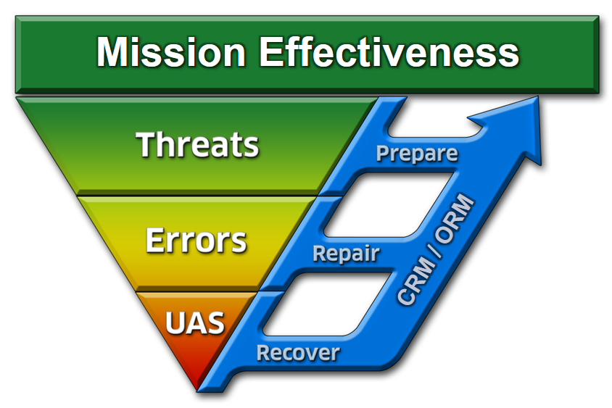
What if We Don’t Repair the Error?
Undesired Aircraft State: A position, speed, attitude, condition, or configuration of an aircraft that reduces safety margins.
29 of 20

Slide 30
How to Manage an Undesired Aircraft State
Identify and RECOVER
Notes:
30

Slide 31
Synopsis

Slide 32
Threat and Error Management
TEM is what we do. CRM is how we do it.
Notes:
MASTER TEM SLIDE

Slide 33
Focus Questions
What threats came “at” the crew and what strategies were used to prepare for threats and initially deal with them?
What errors came “from” the crew and how did they use communication to repair the errors?
What undesired aircraft state was achieved and how did the crew recover?

Slide 34
Mission Effectiveness
MISSION EFFECTIVENESS
What is the mission?

Slide 35
Focus Question #1
What threats came “at” the crew and what strategies were used to prepare for threats and initially deal with them?

Slide 36
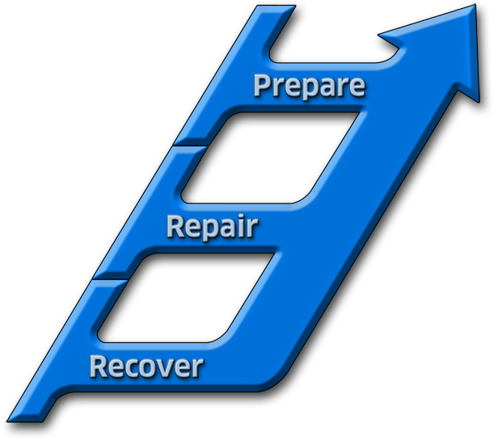
Focus Question #2
What errors came “from” the crew and how did they use CM to repair the errors?
Mission Effectiveness
CRM 7 Critical Skills
Decision Making
Assertiveness
Mission Analysis
Communication
Leadership
Adaptability / Flexibility
Situational Awareness
CRM / ORM
Identify and REPAIR
Notes:
MASTER TEM SLIDE

Slide 37
Focus Question #3
What Undesired Aircraft State was achieved and how did the crew recover?

Slide 38
Remember
The greatest enemy of effective communication is the illusion of it
Effective communication is vital, both inside and outside the cockpit
Be aware of barriers to communication and attempt to overcome them

Slide 39
Questions?

Slide 40
Mission Effectiveness
CRM 7 Critical Skills
Decision Making
Assertiveness
Mission Analysis
Communication
Leadership
Adaptability / Flexibility
Situational Awareness
CRM / ORM
Incident / Accident
Notes:
MASTER TEM SLIDE

